Slide 1
RETAIL SALES DATA ANALYSIS
Exploratory Data Analysis (EDA)
Company: NEXTHIKES IT SOLUTION
Presented by: Vikas Singh

Slide 2
PROJECT OVERVIEW
Analyze retail sales data using Python.
Understand customer and product patterns.
Identify relationships between numerical and categorical variables.
Detect outliers and unusual values.
Generate meaningful business insights.
Raw Data → Cleaning → Analysis → Visualization → Insights

Slide 3
DATASET OVERVIEW
KEY VARIABLES:
Customer: Age, Gender, Customer Segment
Sales: Product Category, Product Price, Quantity,
Discount, Final Price
Operations: Payment Method, Shipping Type,
Delivery Days, Return Status
100,000
ROWS
18
COLUMNS
NO
MISSING VALUES
NO
DUPLICATES

Slide 4
DATA CLEANING & PREPARATION
✓ Checked missing values
✓ Checked duplicate records
✓ Converted Order Date into Date Time format
✓ Checked and prepared numerical & categorical variables
RAW DATA → Missing Values Check → Duplicate Check → Data Type Check → READY FOR ANALYSIS

Slide 5
NUMERICAL DATA ANALYSIS
Variable
Age
Product Price
Quantity
Discount
Final Price
Delivery Days
Mean
41.56
30,164.53
2.50
15.01%
64,165.72
5.51
Key Insight:
Final Price has the highest average monetary value, while average order quantity is approximately 2.5 items.

Slide 6
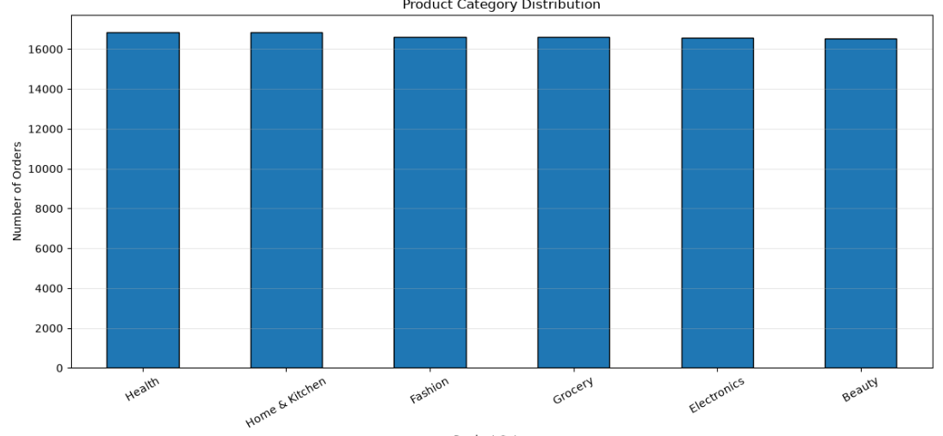
CATEGORICAL DATA ANALYSIS
Gender
Customer Segment
Product Category
Payment Method
Shipping Type
Return Status
Key Insight: Categorical variables were analyzed using frequency distributions to understand customer, product, payment, shipping and return patterns.

Slide 7
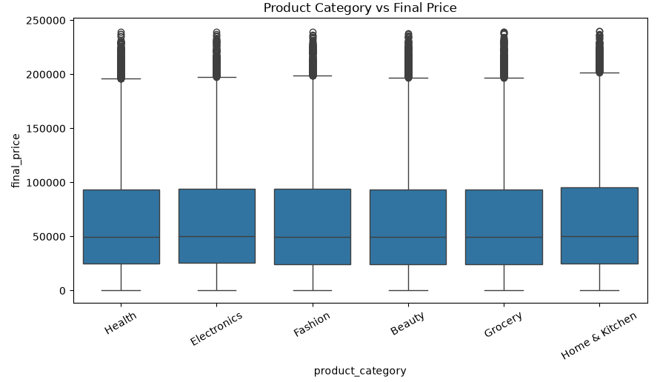
PRODUCT CATEGORY ANALYSIS
Final Price varies across different product categories, helping identify categories with relatively higher or lower sales value.

Slide 8
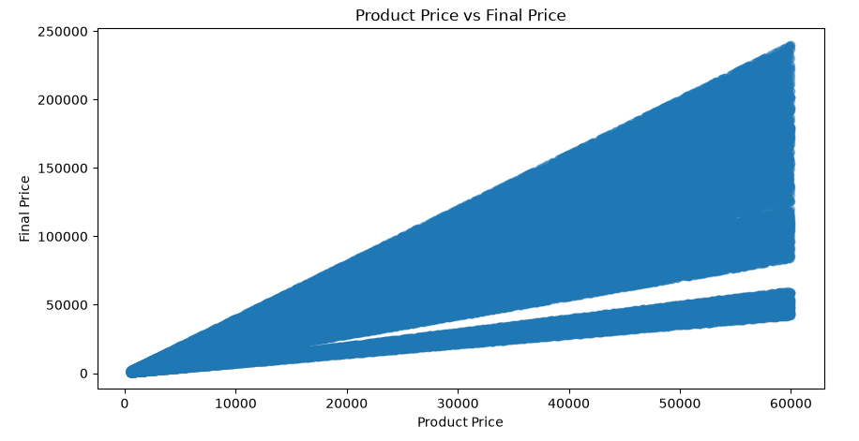
PRICING ANALYSIS
Final Price generally changes with Product Price, showing the relationship between product pricing and final sales value.

Slide 9
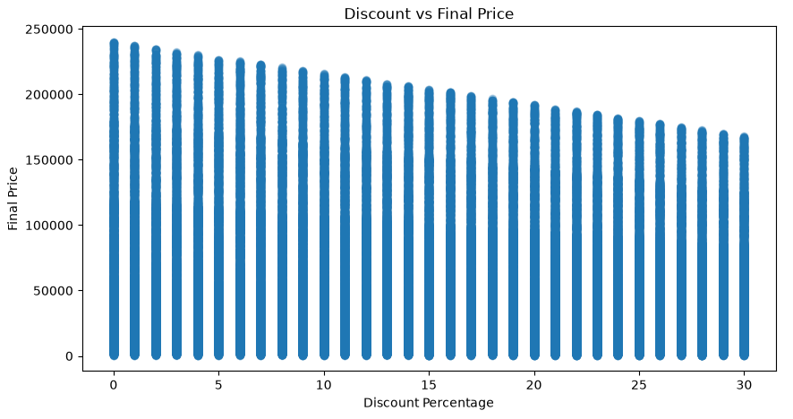
DISCOUNT & QUANTITY ANALYSIS
Discount percentage and final price show a relationship that helps understand the effect of discounts on sales value.

Slide 10
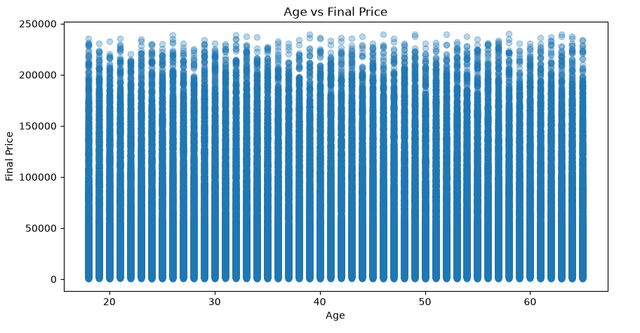
CUSTOMER ANALYSIS
The analysis helps understand how customer age varies with the final price of orders.

Slide 11
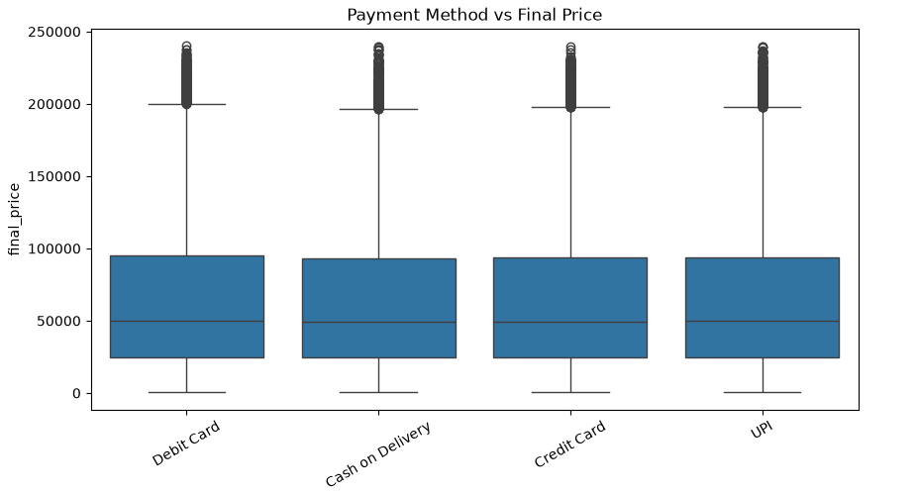
SHIPPING & PAYMENT ANALYSIS
Final Price varies across different payment methods, helping understand the sales value associated with each payment type.

Slide 12
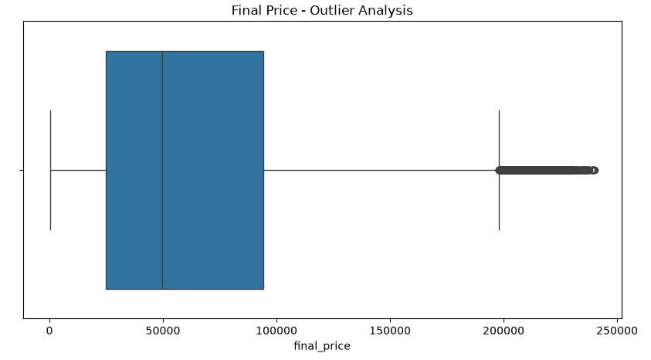
OUTLIER DETECTION
IQR Method
Z-Score Method
Used to identify unusual values.
Based on Q1, Q3 and IQR.
Identifies values with unusually high/low Z-scores.
Threshold used: |Z| > 3
Outlier analysis was performed using IQR and Z-score methods to identify unusually high or low values.

Slide 13
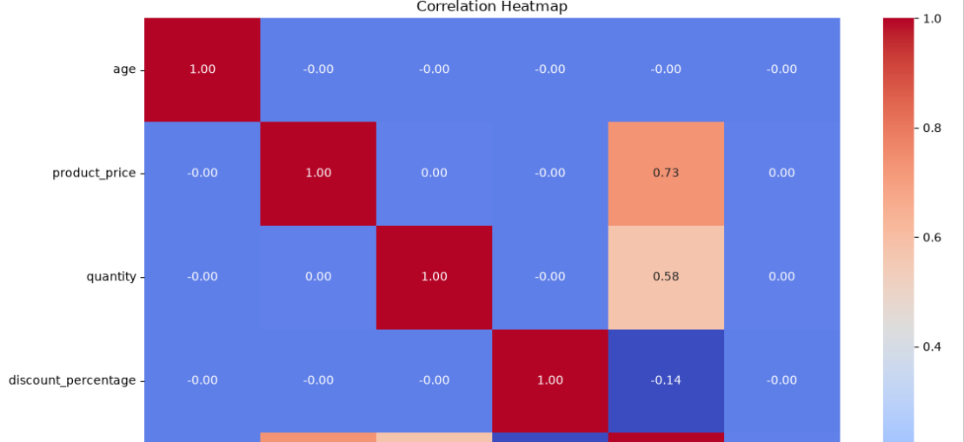
CORRELATION ANALYSIS
Variables analyzed:
Age
Product Price
Quantity
Discount Percentage
Final Price
Delivery Days
The correlation heatmap helps identify the strength and direction of relationships between numerical variables.

Slide 14
SKEWNESS & KURTOSIS ANALYSIS
Variable | Skewness | Kurtosis
Age | -0.005 | -1.201
Product Price | 0.003 | -1.195
Quantity | -0.003 | -1.365
Discount % | -0.004 | -1.202
Final Price | 0.935 | 0.169
Delivery Days | 0.002 | -1.222
Most variables are approximately symmetric. Final Price shows noticeable positive/right skewness, while the other variables have skewness values close to zero.

Slide 15
KEY FINDINGS & INSIGHTS
1. Final Price
Final Price had an average value of 64,165.72 and showed noticeable positive skewness.
2. Product Price
The average Product Price was approximately 30,164.53.
3. Quantity
The average order quantity was approximately 2.5 items.
4. Customer Age
The average customer age was approximately 41.56 years.
5. Data Quality
The dataset contained 100,000 records and 18 columns, with no missing values.
The analysis helped understand customer behavior, product pricing, sales patterns, and unusual values through EDA.

Slide 16
CONCLUSION
The retail dataset was successfully analyzed using Exploratory Data Analysis (EDA).
Numerical and categorical variables were analyzed using different visualizations.
Outliers, correlation, skewness and kurtosis were examined.
The analysis provided useful insights into customers, products, pricing and sales patterns.
EDA helped transform raw retail data into meaningful and understandable insights.

Slide 17
Thank You

